Slide 1
Parallel Programming with CUDA. Basics
Katerina Bolgova, PhD
eScience Research Institute & HPC Department

Slide 2
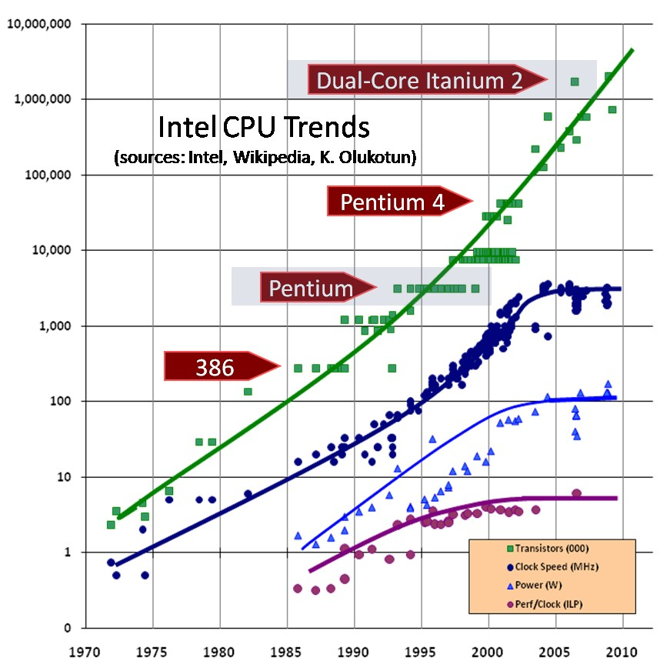
Back to PP concepts…
What is this picture about?

Slide 3
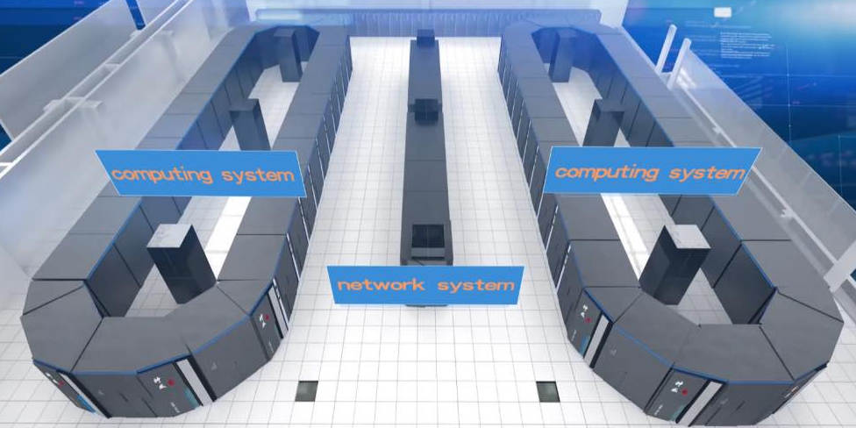

Top 500 supercomputers (November, 2017):
# 1 “Sunway TaihuLight”, China
Total Cores | Power (kW)
10,649,600 | 15,371.00
Rmax (TFlops) | Rpeak (TFlops)
93,014.6 | 125,435.9
#227 “Lomonosov”, Russia
Total Cores | Power (kW)
78,660 | 2,800.00
Rmax (TFlops) | Rpeak (TFlops)
901.9 | 1,700.2

Slide 4




Back to PP concepts…
Moore's law isn't true any longer: It’s impossible to make reliable low-cost processors that run significantly faster
2.3 PFlops
7000 homes
7.0 Megawatts
7.0 Megawatts
Traditional CPUs are
not economically feasible

Slide 5

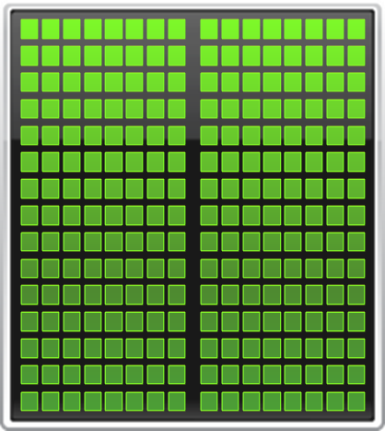

Back to PP concepts…
Parallel Computing / Memory Architectures
Shared Memory
Hybrid Shared-Distributed
Memory
Distributed Memory
And
heterogeneous computing
CPU
GPU

Slide 6
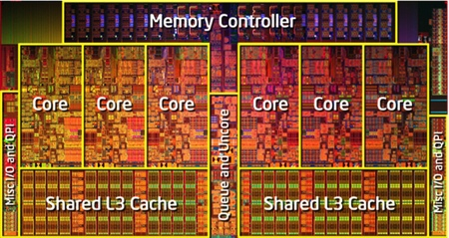
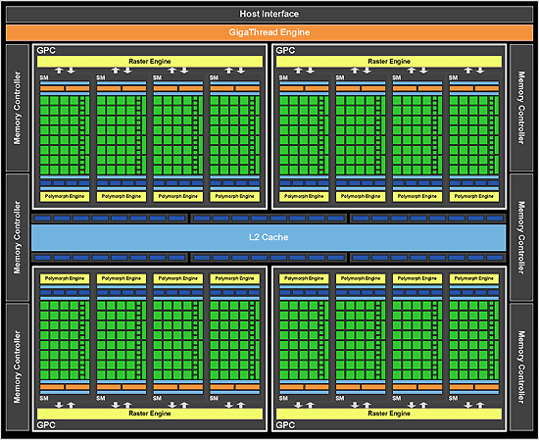
Back to PP concepts…
Intel Core i7
Fermi

Slide 7
Introduction
NVIDIA history: http://www.nvidia.ru/object/corporate-timeline-ru.html
Tesla 10 Architecture
CPU
Bridge
Host Memory
Work Distribution
TPC
TPC
TPC
TPC
TPC
TPC
TPC
TPC
TPC
TPC
Interconnection Network
ROP
L2
ROP
L2
ROP
L2
ROP
L2
ROP
L2
ROP
L2
ROP
L2
ROP
L2
DRAM
DRAM
DRAM
DRAM
DRAM
DRAM
DRAM
DRAM

Slide 8
Introduction
Tesla 20 Architecture (SM)
Tesla 10 Architecture
(Streaming multiprocessor, SM)
Instruction Cache
Uniform Cache
Streaming Multiprocessor
Warp Scheduler
Warp Scheduler
Instruction $
Constant $
Dispatch Unit
Dispatch Unit
Instruction Fetch
Register File (32768 32-bit words)
Shared Memory
Core
Core
Core
Core
LD/ST
LD/ST
SFU
SP
SFU
SP
SFU
Core
Core
Core
Core
LD/ST
LD/ST
SP
SP
Core
Core
Core
Core
LD/ST
LD/ST
SFU
SP
SP
Core
Core
Core
Core
LD/ST
LD/ST
SP
SP
Core
Core
Core
Core
LD/ST
LD/ST
SFU
Register File
Core
Core
Core
Core
LD/ST
LD/ST
Core
Core
Core
Core
LD/ST
LD/ST
SFU
Double Precision
Core
Core
Core
Core
LD/ST
LD/ST
Interconnection network
64 Kb Shared Memory/ L1 Cache
Uniform Cache

Slide 9
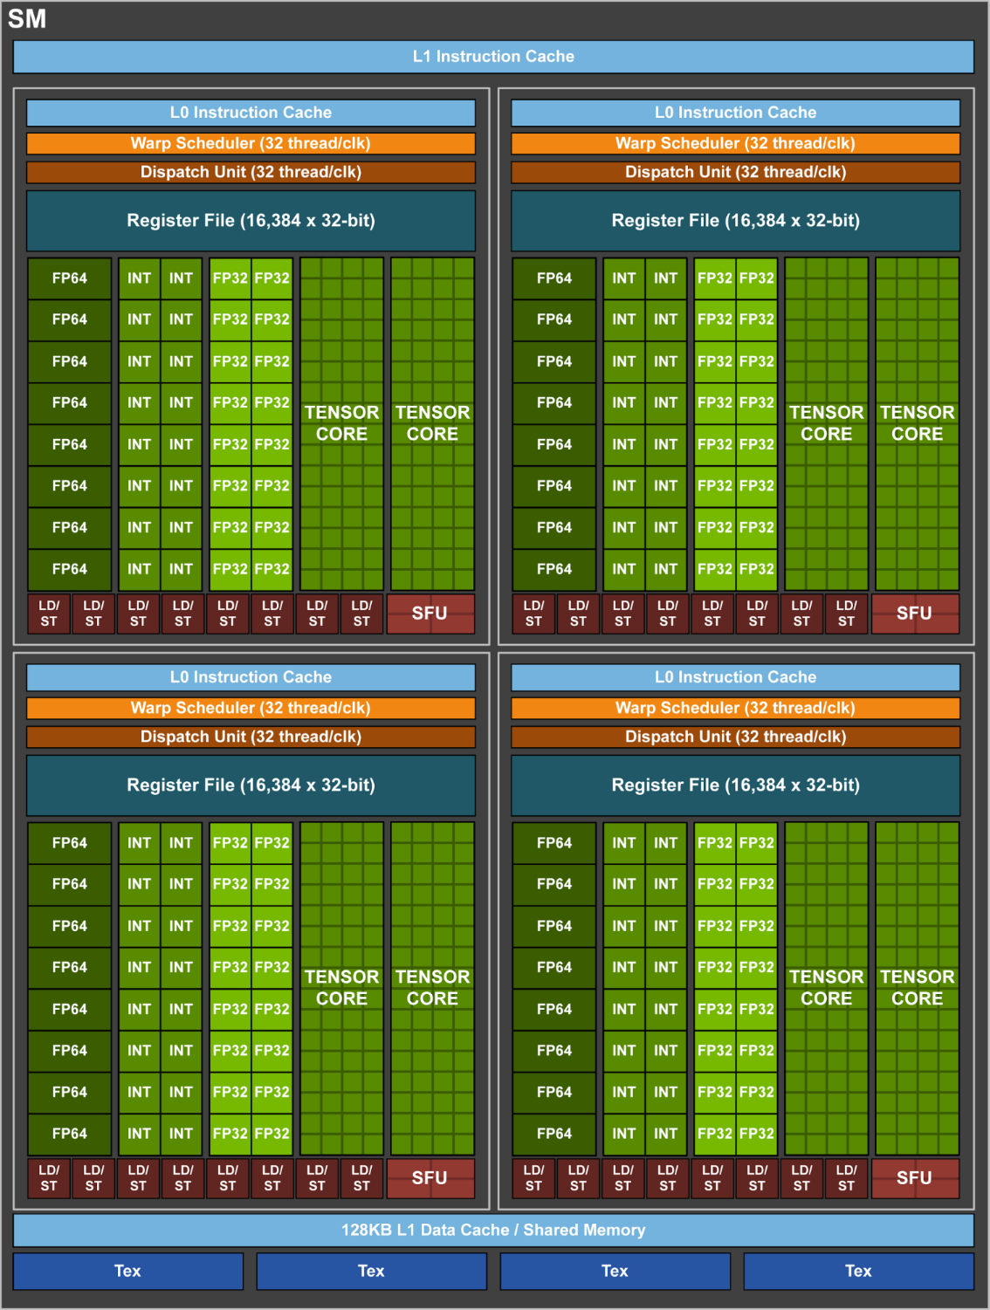
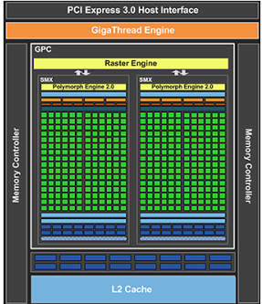
Introduction
NVIDIA accelerators:
Fermi
Kepler
Maxwell
Pascal
Volta

Slide 10
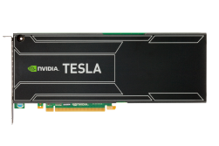

CPU vs. GPU
Here was a video. You can find it by link:
https://www.youtube.com/watch?v=-P28LKWTzrI
Tesla K20X vs Xeon CPU
8x Faster SGEMM
6x Faster DGEMM
Tesla K20X vs Xeon Phi
90% Faster SGEMM
60% Faster DGEMM

Slide 11
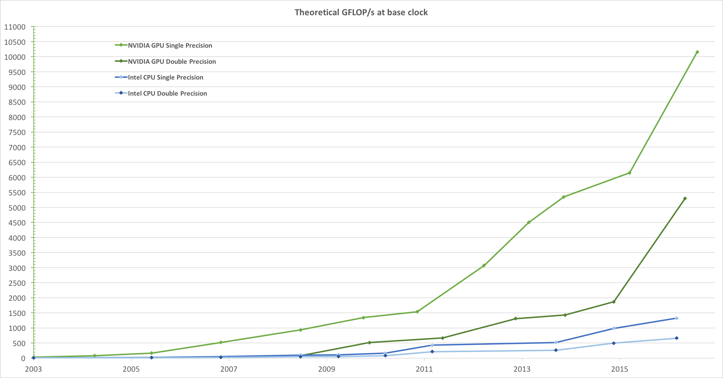
GPGPU
* CUDA C Programming Guide

Slide 12
GPGPU
General-Purpose computing on Graphics Processing Units:
became practical and popular after 2001, with the advent of both programmable shaders and floating point support on graphics processors
Most popular implementations:
OpenCL
DirectCompute
CUDA

Slide 13
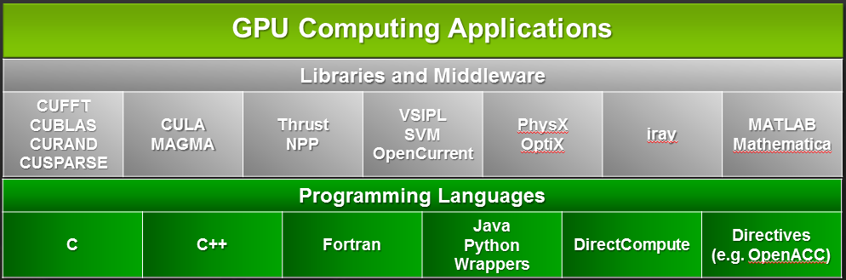
Compute Unified Device Architecture
CUDA® - a General-Purpose Parallel Computing Platform and Programming Model:
was introduced by NVIDIA in 2006
expose GPU computing for general purpose
is designed to support various languages and application programming interfaces
CUDA C/C++ - Small set of extensions to enable heterogeneous programming

Slide 14


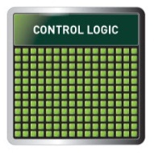
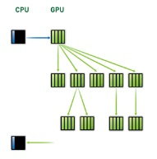
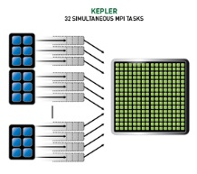
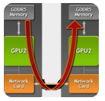
Compute Unified Device Architecture
Programming Approaches
Libraries
OpenACC Directives
Programming Languages
“Drop-in” Acceleration
Easily Accelerate Apps
Maximum Flexibility
Development
Environment
Nsight IDE
Linux, Mac and Windows
GPU Debugging and Profiling
CUDA-GDB debugger
NVIDIA Visual Profiler
Open Compiler
Tool Chain
Enables compiling new languages to CUDA platform, and CUDA languages to other architectures
Hardware Capabilities
SMX
Dynamic Parallelism
HyperQ
GPUDirect

Slide 15
Compute Unified Device Architecture
The CUDA Toolkit:
is free
available at https://developer.nvidia.com
includes a compiler, math libraries and tools for debugging and optimizing the performance of applications
There are a lot of code samples, programming guides, user manuals, API references and other documentation. Most useful of them:
CUDA Programming Guide,
http://docs.nvidia.com/cuda/cuda-c-programming-guide/
CUDA C Best Practices Guide,
http://docs.nvidia.com/cuda/cuda-c-best-practices-guide

Slide 16
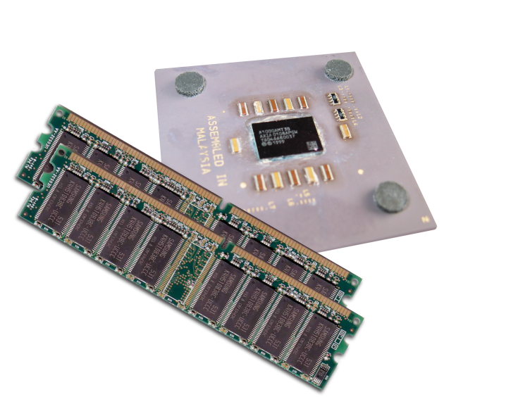
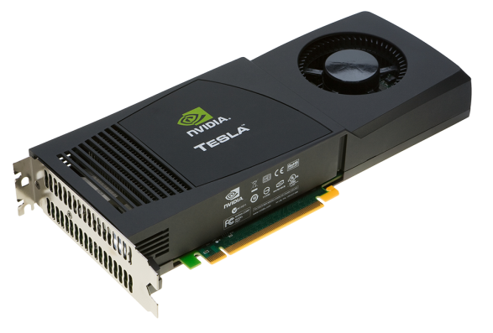
Heterogeneous Computing
Terminology:
Host The CPU and its memory (host memory)
Device The GPU and its memory (device memory)
Host
Device

Slide 17
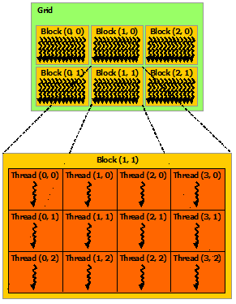
CUDA. Programming Model
Basic concepts:
Host: The CPU and its memory (host memory). Serial code is executed here.
Device: The GPU and its memory (device memory). Parallel code is executed here.
Kernel: function that is executed N times in parallel
kernels are executed by N different CUDA threads. Each thread has its own unique ID (treadIdx)
Threads form a 1/2/3-dimensional block
Blocks are organized into 1/2/3-dimensional grid

Slide 18
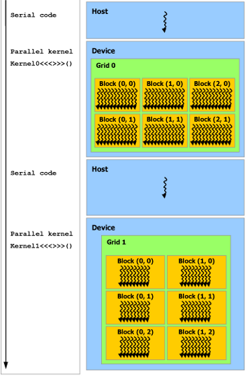
CUDA. Programming Model
Thread blocks are required to execute independently: It must be possible to execute them in any order, in parallel or in series
There is a limit to the number of threads per block
Threads within a block can cooperate by sharing data
Kernel=grid

Slide 19
Simple Processing Flow
Prepare data on CPU
Copy input data from CPU memory to GPU memory
Load GPU code and execute it
Copy results from GPU memory to CPU memory

Slide 20
“Hello world” with GPU
__global__ void mykernel(void) {
}
int main(void) {
mykernel<<<1,1>>>();
printf("Hello World!\n");
return 0;
}
CUDA C/C++ keyword __global__ indicates a function that runs on the device.
Triple angle brackets (mykernel<<<1,1>>>()) mark a call from host code to device code (also called a “kernel launch”).
nvcc separates source code into host and device components:
Device functions (e.g. mykernel()) processed by NVIDIA compiler
Host functions (e.g. main()) processed by standard host compiler (gcc, cl.exe)
That’s ‘minimum’ that needs to execute a function on the GPU

Slide 21
CUDA runtime API. Basics
The Compute Capability describes the features supported by a CUDA hardware.
Build-in structure cudaDeviceProp contains all information about device Compute Capabitity
GPU | Compute Capability
GeForce GTX 980 M | 5.2
GeForce GTX 770 | 5.0
Tesla K40 | 3.5
Tesla C2050/C2070 | 2.0
GeForce GTX 480M | 2.0
GeForce 8800 GT | 1.1
GeForce 8800 GTX | 1.0

Slide 22
CUDA runtime API. Basics
int main ( int argc, char * argv [] )
{
int deviceCount;
cudaDeviceProp devProp;
cudaGetDeviceCount ( &deviceCount );
printf ( "Found %d devices\n", deviceCount );
for ( int device = 0; device < deviceCount; device++ )
{
cudaGetDeviceProperties ( &devProp, device );
printf ( "Device %d\n", device );
printf ( "Compute capability : %d.%d\n", devProp.major, devProp.minor );
printf ( "Name : %s\n", devProp.name );
printf ( "Total Global Memory : %d\n", devProp.totalGlobalMem );
printf ( "Shared memory per block: %d\n", devProp.sharedMemPerBlock );
printf ( "Registers per block : %d\n", devProp.regsPerBlock );
printf ( "Warp size : %d\n", devProp.warpSize );
printf ( "Max threads per block : %d\n", devProp.maxThreadsPerBlock );
printf ( "Total constant memory : %d\n", devProp.totalConstMem );
printf ( "Multiprocessor Count : %d\n", devProp.devProp.mгltiProcessorCount);
}
return 0;
}
Demo

Slide 23
CUDA C/C++
It consists of a minimal set of extensions to the C language and a runtime library.
Extensions allow programmers to define a kernel as a C function and use some new syntax to specify the grid and block dimension each time the function is called:
Function Type Qualifiers
Variable Type Qualifiers
Built-in Vector Types
Built-in Variables

Slide 24
CUDA C. Function Type Qualifiers
Qualifier | Executed at | Called from
__device__ | device | device
__global__ | device | host
__host__ | host | host
The __global__ qualifier declares a function as being a kernel.
__global__ functions must have void return type
A call to a __global__ function is asynchronous
The __device__ and __host__ qualifiers can be used together however, in which case the function is compiled for both the host and the device.
The __global__ and __host__ qualifiers cannot be used together
It is equivalent to declare a function with only the __host__ qualifier or to declare it without any of qualifiers

Slide 25
CUDA C. Built-in Vector Types
Vector types are derived from the basic integer and floating-point types:
(u)char, (u)int, (u)short, (u)long, float could have 1-/ 2-/ 3-/ 4-dimensions
longlong, double could have 1-/ 2-dimensions
the 1st, 2nd, 3rd, and 4th components are accessible through the fields x, y, z, and w, respectively
They all come with a constructor function:
Example:
The type dim3 is an integer vector type based on uint3 that is used to specify dimensions. When defining a variable of type dim3, any component left unspecified is initialized to 1.
make_<type name>
float4 b = make_float4 ( 1, 2, 5, 3 );

Slide 26
CUDA C. Built-in Variables
Built-in variables specify the grid and block dimensions and the block and thread indices. They are only valid within functions that are executed on the device
dim3 gridDim — contains the dimensions of the grid,
uint3 blockIdx — contains the block index within the grid,
dim3 blockDim — contains the dimensions of the block,
uint3 threadIdx — contains the thread index within the block,

Slide 27
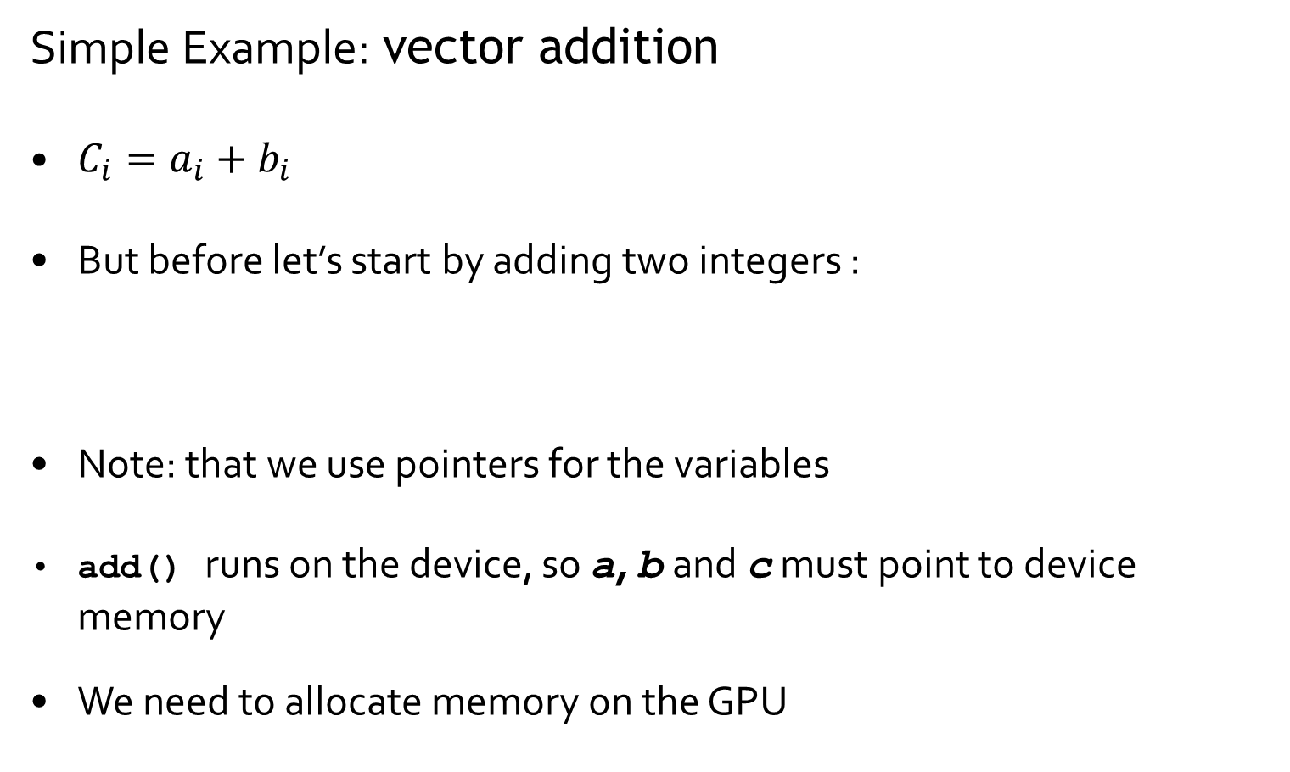
CUDA C/C++ Programming
Simple Example: vector addition
$C_{i}=a_{i}+b_{i}$
But before let’s start by adding two integers :
Note: that we use pointers for the variables
add() runs on the device, so a, b and c must point to device memory
We need to allocate memory on the GPU
__global__ void add(int *a, int *b, int *c) {
*c = *a + *b;
}
a
b
c

Slide 28
Memory Management
Host and device memory are separate entities
Device pointers point to GPU memory
May be passed to/from host code
May not be dereferenced in host code
Host pointers point to CPU memory
May be passed to/from device code
May not be dereferenced in device code
Simple CUDA API for handling device memory
cudaMalloc(), cudaFree(), cudaMemcpy()
Similar to the C equivalents malloc(), free(), memcpy()
P C I

Slide 29
Memory Management
cudaError_t cudaMalloc ( void ** devPtr, size_t size );
cudaError_t cudaFree ( void * devPtr );
cudaError_t cudaMemcpy ( void * dst, const void * src,
size_t count, enum cudaMemcpyKind kind );
cudaError_t cudaMemcpyAsync ( void * dst, const void * src,
size_t count,
enum cudaMemcpyKind kind,
cudaStream_t stream );
cudaError_t cudaMemset ( void * dst, int value, size_t count );
cudaError_t cudaMallocHost ( void ** devPtr, size t size );

Slide 30
CUDA C/C++ Programming
int main() {
int a, b, c; // host copies of a, b, c
int *d_a, *d_b, *d_c; // device copies of a, b, c
int size = sizeof(int);
// Allocate space for device copies of a, b, c
cudaMalloc((void **)&d_a, size);
cudaMalloc((void **)&d_b, size);
cudaMalloc((void **)&d_c, size);
// Setup input values
a = 2;
b = 7;
// Copy inputs to device
cudaMemcpy(d_a, &a, size, cudaMemcpyHostToDevice);
cudaMemcpy(d_b, &b, size, cudaMemcpyHostToDevice);
// Launch add() kernel on GPU
add<<<1,1>>>(d_a, d_b, d_c);
// Copy result back to host
cudaMemcpy(&c, d_c, size, cudaMemcpyDeviceToHost);
// Cleanup
cudaFree(d_a); cudaFree(d_b); cudaFree(d_c);
return 0;
}

Slide 31
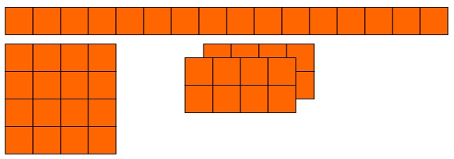
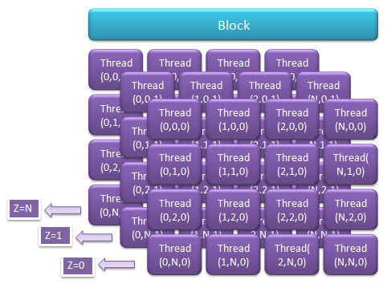
CUDA C/C++. Kernel Launch
Kernel_name<<<grid, block, mem, stream>>>( params ),
Where:
- dim3 grid — grid size (number of block);
- dim3 block — block size (thread number per block).
- size_t mem — amount of shared memory per block;
- cudaStream_t stream — CUDA stream number.

Slide 32
CUDA C. Indexing Arrays with Blocks and Threads
Consider indexing an array with one element per thread (8 threads/block)
threadIdx.x
threadIdx.x
threadIdx.x
threadIdx.x
0
1
2
3
4
5
6
7
0
1
2
3
4
5
6
7
0
1
2
3
4
5
6
7
0
1
2
3
4
5
6
7
blockIdx.x = 0
blockIdx.x = 1
blockIdx.x = 2
blockIdx.x = 3
With M threads/block a unique index for each thread is given by:
int index = threadIdx.x + blockIdx.x * M;
Which thread will operate on the red element?
M = 8
threadIdx.x = 5
0
1
2
3
4
5
6
7
8
9
10
11
12
13
14
15
16
17
18
19
20
21
22
23
24
25
26
27
28
29
30
31
blockIdx.x = 2
int index = threadIdx.x + blockIdx.x * M;
= 5 + 2 * 8;
= 21;

Slide 33
CUDA C. Indexing Arrays with Blocks and Threads
Consider indexing an array with one element per thread (8 threads/block)
threadIdx.x
threadIdx.x
threadIdx.x
threadIdx.x
0
1
2
3
4
5
6
7
0
1
2
3
4
5
6
7
0
1
2
3
4
5
6
7
0
1
2
3
4
5
6
7
blockIdx.x = 0
blockIdx.x = 1
blockIdx.x = 2
blockIdx.x = 3
With M threads/block a unique index for each thread is given by:
int index = threadIdx.x + blockIdx.x * blockDim.x;
Which thread will operate on the red element?
M = 8
threadIdx.x = 5
0
1
2
3
4
5
6
7
8
9
10
11
12
13
14
15
16
17
18
19
20
21
22
23
24
25
26
27
28
29
30
31
blockIdx.x = 2
int index = threadIdx.x + blockIdx.x * blockDim.x;
= 5 + 2 * 8;
= 21;

Slide 34
CUDA C. Vector Addition
__global__ void vector_add(float *a, float *b, float *c)
{
int index = blockIdx.x * blockDim.x + threadIdx.x;
c[index] = a[index] + b[index];}
int main() {
...
// Kernel invocation with one block of N * N * 1 threads
int numBlocks = 1;
dim3 threadsPerBlock(N, N);
vector_add<<<numBlocks, threadsPerBlock>>>(A, B, C);
...
}

Slide 35
CUDA runtime API .Time Measurement
Event in CUDA is cudaEvent_t object that is used for indicate “the point” of some event. It’s used for event management.
cudaError_t cudaEventCreate ( cudaEvent_t * );
cudaError_t cudaEventRecord ( cudaEvent_t *, cudaStream_t );
cudaError_t cudaEventQuery ( cudaEvent_t );
cudaError_t cudaEventSynchronize ( cudaEvent_t );
cudaError_t cudeEventElapsedTime ( float * time, cudaEvent_t st, cudaEvent_t sp );
cudaError_t cudaEventDestroy ( cudaEvent_t );

Slide 36
CUDA C. Vector Addition
int main() {
...
cudaEvent_t start, stop;
cudaEventCreate(&start);
cudaEventCreate(&stop);
float gpuTime;
...
cudaEventRecord ( start, 0 );
...
vector_add<<<numBlocks, threadsPerBlock>>>(A, B, C);
...
cudaEventRecord ( stop, 0);
cudaEventSynchronize (stop) ;
cudaEventElapsedTime (&gpuTime, start, stop );
printf("time spent executing bу the GPU: %.2f millseconds\n", gpuTime );
cudaEventDestroy (start);
cudaEventDestroy (stop);
...
}
Demo

Slide 37
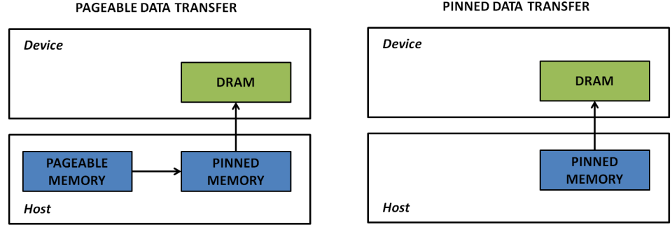
CUDA C. Pinned-memory
Host (CPU) data allocations are pageable by default.
the CUDA driver must first allocate a temporary page-locked, or “pinned”, host array, copy the host data to the pinned array, and then transfer the data from the pinned array to device memory
malloc(…) and cudaMemcpy /
free(…)
cudaMallocHost() or cudaHostAlloc() / cudaFreeHost(…)
* How to Optimize Data Transfers in CUDA C/C++:
https://devblogs.nvidia.com/parallelforall/how-optimize-data-transfers-cuda-cc/
Demo

Slide 38
CUDA. Memory Hierarchy
Memory Type | Access | Level | Speed | Localization
Registers | R/W | Per-thread | High | SM
Local | R/W | Per-thread | Low | DRAM
Shared | R/W | Per-block | High | SM
Global | R/W | Per-grid | Low | DRAM
Constant | R/O | Per-grid | High | DRAM
Texture | R/O | Per-grid | High | DRAM

Slide 39
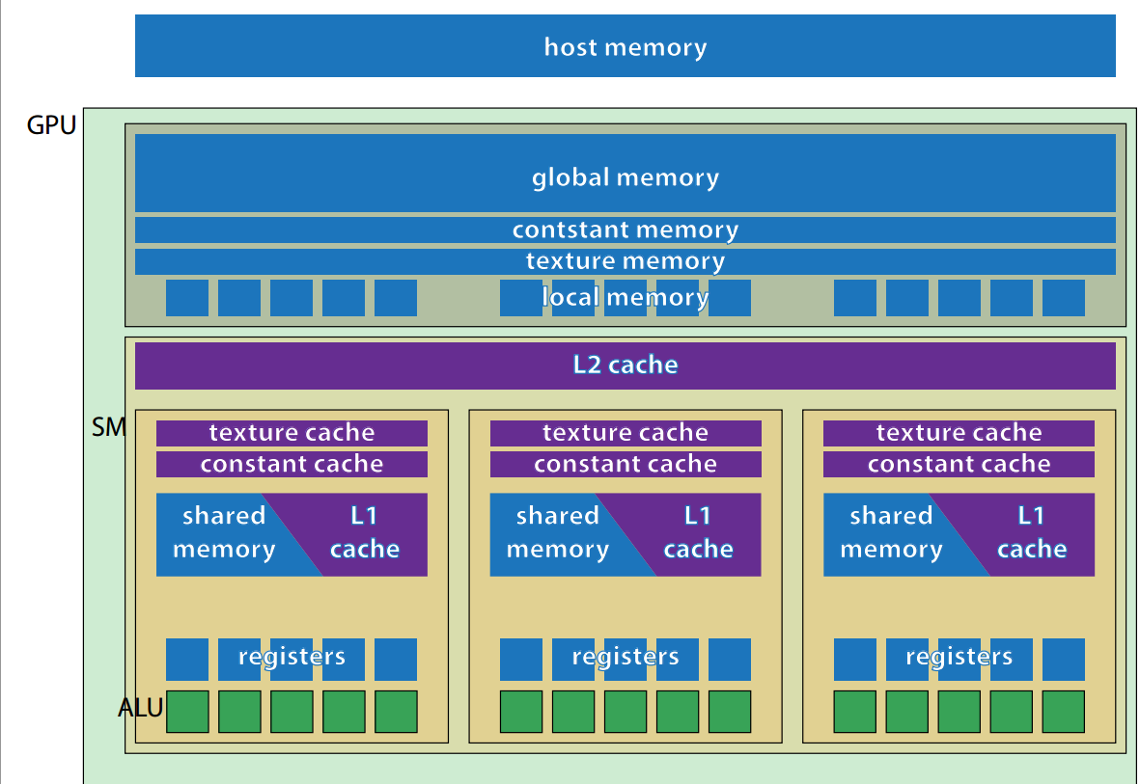
CUDA. Memory Hierarchy

Slide 40

CUDA. Memory Hierarchy
Memory Type | Access | Level | Speed | Localization
Registers | R/W | Per-thread | High | SM
Local | R/W | Per-thread | Low | DRAM
Shared | R/W | Per-block | High | SM
Global | R/W | Per-grid | Low | DRAM
Constant | R/O | Per-grid | High | DRAM
Texture | R/O | Per-grid | High | DRAM

Slide 41
Sample. Matrix Multiplication
Consider 2 matrices A и B with (N*N) size
Each block calculates a part of result matrix C
Each thread in block calculates 1 element in this part
To simplify:
N = 2048
Block_size = 32
Each matrix is 1D array
B
B’
A
C
A’
C’

Slide 42
Matrix Multiplication. Kernel
#define BLOCK_SIZE 32
#define N 2048
__global__ void matMult ( float * a, float * b, int n, float * c )
{
int bx = blockIdx.x;
int by = blockIdx.y;
int tx = threadIdx.x;
int ty = threadIdx.y;
float sum = 0.0f;
int ia = n * BLOCK_SIZE * by + n * ty;
int ib = BLOCK_SIZE * bx + tx;
int ic = ia + ib;
for (int k = 0; k < n; k++)
sum += a[ia + k] * b[ib + k*n];
c[ic] = sum;
}

Slide 43
Matrix Multiplication. Main ()
int numBytes = N * N * sizeof(float); //define memory size
// allocate host memory
float * h_A = (float*)malloc(N * N * sizeof(float));;
float * h_B = (float*)malloc(N * N * sizeof(float));;
float * h_C = (float*)malloc(N * N * sizeof(float));;
/*init matrix*/ ...
//assign variable for device
float * d_A; float * d_B; float * d_C;
// allocate device memory
cudaMalloc((void**)&d_A, numBytes);
cudaMalloc((void**)&d_B, numBytes);
cudaMalloc((void**)&d_C, numBytes);
// set kernel launch configuration
dim3 threads(BLOCK_SIZE, BLOCK_SIZE);
dim3 blocks(N / BLOCK_SIZE, N / BLOCK_SIZE);
/*...*/
//copy data from host to device
cudaMemcpy(d_A, h_A, numBytes, cudaMemcpyHostToDevice);
cudaMemcpy(d_B, h_B, numBytes, cudaMemcpyHostToDevice);

Slide 44
Matrix Multiplication. Main ()
//kernel launch
matMult_Global_mem<<<blocks,threads>>> (d_A, d_B, N, d_C);
//copy data from device to host
cudaMemcpy(h_C, d_C, numBytes, cudaMemcpyDeviceToHost);
/*...*/
//memory free
cudaFree(d_A);
cudaFree(d_B);
cudaFree(d_C);
free(h_A);
free(h_B);
free(h_C);
return 0;
}

Slide 45

Matrix Multiplication. Global memory
Sequential code:
CPU: Intel Core i7 58-20K 3,3 GHz
Dram: 16 GB
GPU code:
Name :GeForce GTX 960
Compute capability : 5.2
 | Execution Time | Rate
Sequential code | 69773,2 | -
Global Memory | 3230 | 21,6
BUT :
Each element (thread)
2*N arithmetic operations
2*N accesses to global memory
Global Memory has a low access speed (200-400 clock cycles)

Slide 46
CUDA. Shared memory
is much faster than global memory
is allocated per thread block, so all threads in the block have access to the same shared memory.
Threads can access data in shared memory loaded from global memory by other threads within the same thread block
When sharing data between threads, we need to be careful to avoid race conditions
Usage pattern
__shared__ int dSt[32];
__shared__ float dSum;
extern __shared__ int dDyn[];
/*Load data from Global memory*/
__syncthreads()
/* some calculations */
__syncthreads()
/* write result to global memory */

Slide 47
Matrix Multiplication
During the calculation of the matrix C’ is constantly used the same elements from matrices A and B
Repeatedly read from the global memory
B
B’
These reusable elements form stripes in the matrices A and B
The size of this strip is N*32 and even one such strip is not placed in the shared-memory
A
C
A’
C’
32*2048*sizeof(float) = 256 Кбайт

Slide 48
Matrix Multiplication. Shared memory
Divide each strip into square matrix (32*32)
Then required submatrix C’ can be represented as a sum of products of such matrices 32*32
For calculations we need only two matrix 32*32 in shared-memory
B
A
C
=
*ссм
+…+
*ссм
C’
4*32*32*sizeof(float) = 16 Кбайт

Slide 49
Matrix Multiplication. Shared memory. Kernel
__global__ void matMult_1 ( float * a, float * b, int n, float * c ) {
int bx = blockIdx.x, by = blockIdx.y;
int tx = threadIdx.x, ty = threadIdx.y;
int aBegin = n * BLOCK_SIZE * by;
int aEnd = aBegin + n - 1;
int bBegin = BLOCK_SIZE * bx;
int aStep = BLOCK_SIZE, bStep = BLOCK_SIZE * n;
float sum = 0.0f;
__shared__ float as [BLOCK_SIZE][BLOCK_SIZE];
__shared__ float bs [BLOCK_SIZE][BLOCK_SIZE];
for ( int ia = aBegin, ib = bBegin; ia <= aEnd;
ia += aStep, ib += bStep ){
as [tx][ty] = a [ia + n * ty + tx];
bs [tx][ty] = b [ib + n * ty + tx];
__syncthreads ();
for ( int k = 0; k < BLOCK_SIZE; k++ )
sum += as [k][ty] * bs [tx][k];
__syncthreads ();
}
c [aBegin + bBegin + n * ty + tx] = sum;
}

Slide 50

Matrix Multiplication. Results
Sequential code:
CPU: Intel Core i7 58-20K 3,3 GHz
Dram: 16 GB
GPU code:
Name :GeForce GTX 960
Compute capability : 5.2
 | Execution Time | Rate
Sequential code | 69773,2 | -
Global Memory | 3230 | 21,6
Shared Memory | 3151,4 | 22,14

Slide 51
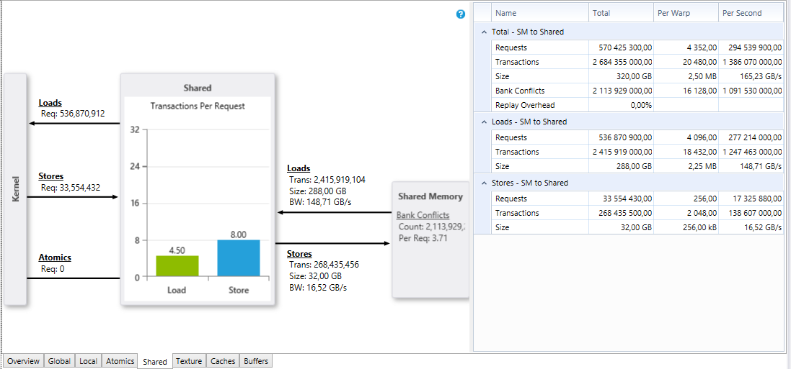
CUDA Toolkit. Profiling
Visual Profiler
NSight

Slide 52
Shared Memory. Bank conflicts
shared memory is divided into equally sized memory modules (banks) that can be accessed simultaneously.
Shared memory banks are organized such that successive 32-bit words are assigned to successive banks and the bandwidth is 32 bits per bank per clock cycle.
If multiple threads’ requested addresses map to the same memory bank, the accesses are serialized (Bank conflicts).

Slide 53
Shared Memory. Bank conflicts
Thread 0
Bank 0
Thread 0
Bank 0
Thread 1
Bank 1
Thread 1
Bank 1
Thread 2
Bank 2
Thread 2
Bank 2
V
Thread 3
Bank 3
Thread 3
Bank 3
Thread 4
Bank 4
V
Thread 4
Bank 4
Thread 5
Bank 5
Thread 5
Bank 5
Thread 6
Bank 6
Thread 6
Bank 6
Thread 7
Bank 7
Thread 7
Bank 7
Thread 8
Bank 8
Thread 8
Bank 8
Thread 9
Bank 9
Thread 9
Bank 9
Thread 10
Bank 10
Thread 10
Bank 10
Thread 11
Bank 11
Thread 11
Bank 11
Thread 12
Bank 12
Thread 12
Bank 12
Thread 13
Bank 13
Thread 13
Bank 13
Thread 14
Bank 14
Thread 14
Bank 14
Thread 15
Bank 15
Thread 15
Bank 15

Slide 54
Shared Memory. Bank conflicts
x2
Thread 0
Bank 0
x6
Thread 0
Bank 0
Thread 1
Bank 1
Thread 1
Bank 1
Thread 2
Bank 2
Thread 2
Bank 2
Thread 3
Bank 3
Thread 3
Bank 3
Thread 4
Bank 4
Thread 4
Bank 4
Thread 5
Bank 5
Thread 5
Bank 5
Thread 6
Bank 6
Thread 6
Bank 6
Thread 7
Bank 7
Thread 7
Bank 7
Thread 8
Bank 8
Thread 8
Bank 8
Thread 9
Bank 9
Thread 9
Bank 9
Thread 10
Bank 10
Thread 10
Bank 10
Thread 11
Bank 11
Thread 11
Bank 11
Thread 12
Bank 12
Thread 12
Bank 12
Thread 13
Bank 13
Thread 13
Bank 13
Thread 14
Bank 14
Thread 14
Bank 14
Thread 15
Bank 15
Thread 15
Bank 15

Slide 55
Sample. Matrix Multiplication (16*16)
The multiplication of two matrices 16*16, located in the shared memory
Access to one matrix is by rows, to the another - by columns
0 | 1 | 2 | 3 | 4 | 5 | 6 | 7 | 8 | 9 | 10 | 11 | 12 | 13 | 14 | 15
…
All of the elements of the row are distributed evenly across the 16 banks. There are no conflicts
All the elements of a column are in one Bank. 16-th order bank conflict

Slide 56
Sample. Matrix Multiplication (16*16)
Complete each line with one (fictitious) element
0 | 1 | 2 | 3 | 4 | 5 | 6 | 7 | 8 | 9 | 10 | 11 | 12 | 13 | 14 | 15 | 16
…
…
All column elements are in different banks
Actually, by slightly increasing the amount of memory completely got rid of the conflicts

Slide 57
Matrix Multiplication. Shared memory. V.2
__global__ void matMult_2 ( float * a, float * b, int n, float * c ) {
int bx = blockIdx.x, by = blockIdx.y;
int tx = threadIdx.x, ty = threadIdx.y;
int aBegin = n * BLOCK_SIZE * by;
int aEnd = aBegin + n - 1;
int bBegin = BLOCK_SIZE * bx;
int aStep = BLOCK_SIZE, bStep = BLOCK_SIZE * n;
float sum = 0.0f;
__shared__ float as [BLOCK_SIZE][BLOCK_SIZE+1];
__shared__ float bs [BLOCK_SIZE][BLOCK_SIZE+1];
for ( int ia = aBegin, ib = bBegin; ia <= aEnd;
ia += aStep, ib += bStep ){
as [tx][ty] = a [ia + n * ty + tx];
bs [tx][ty] = b [ib + n * ty + tx];
__syncthreads ();
for ( int k = 0; k < BLOCK_SIZE; k++ )
sum += as [k][ty] * bs [tx][k];
__syncthreads ();
}
c [aBegin + bBegin + n * ty + tx] = sum;
}

Slide 58
Matrix Multiplication. Shared memory. v.3
__global__ void matMult_2 ( float * a, float * b, int n, float * c ) {
int bx = blockIdx.x, by = blockIdx.y;
int tx = threadIdx.x, ty = threadIdx.y;
int aBegin = n * BLOCK_SIZE * by;
int aEnd = aBegin + n - 1;
int bBegin = BLOCK_SIZE * bx;
int aStep = BLOCK_SIZE, bStep = BLOCK_SIZE * n;
float sum = 0.0f;
__shared__ float as [BLOCK_SIZE][BLOCK_SIZE];
__shared__ float bs [BLOCK_SIZE][BLOCK_SIZE];
for ( int ia = aBegin, ib = bBegin; ia <= aEnd;
ia += aStep, ib += bStep ){
as [ty][tx] = a [ia + n * ty + tx];
bs [ty][tx] = b [ib + n * ty + tx];
__syncthreads ();
for ( int k = 0; k < BLOCK_SIZE; k++ )
sum += as [ty][k] * bs [k][tx];
__syncthreads ();
}
c [aBegin + bBegin + n * ty + tx] = sum;
}

Slide 59
Matrix Multiplication. Results
Sequential code:
CPU: Intel Core i7 58-20K 3,3 GHz
Dram: 16 GB
GPU code:
Name :GeForce GTX 960
Compute capability : 5.2
 | Execution Time | Rate
Sequential code | 69773,2 | -
Global Memory | 3230 | 21,6
Shared Memory 1 | 3151,4 | 22,14
Shared Memory 2/3 | 1652 | 42,5

Slide 60
TLP vs ILP
Thread-Level Parallelism (TLP)
Instruction-Level
Parallelism (ILP)
Thread_0
X[0]=F(0)
X[0]=X[0]+S
X[0]=X[0]*T
Thread_1
X[1]=F(1)
X[1]=X[1]+S
X[1]=X[1]*T
Thread_2
X[2]=F(2)
X[2]=X[2]+S
X[2]=X[2]*T
Thread_NN
X[0] = F(0)
X[1] = F(1)
X[2] = F(2)
X[0] = X[0]+S
X[1] = X[1]+S
X[2] = X[2]+S
X[0] = X[0]*T
X[1] = X[1]*T
X[2] = X[1]*T
Independent operations

Slide 61
Matrix Multiplication. Shared memory. v.4
Instead of lines in kernel (in v.3)
float sum = 0.0f;
as [ty][tx] = a [ia + n * ty + tx];
bs [ty][tx] = b [ib + n * ty + tx];
sum += as [ty][k] * bs [k][tx];
c [aBegin + bBegin + n * ty + tx] = sum;
Following lines
float sum1 = 0.0f, sum2 = 0.0f;
as[ty][tx] = a[ia + n * ty + tx];
bs[ty][tx] = b[ib + n * ty + tx];
as[ty+16][tx] = a[ia + n * (ty + 16) + tx];
bs[ty+16][tx] = b[ib + n * (ty + 16) + tx];
sum1 += as[ty][k] * bs[k][tx];
sum2 += as[ty + 16][k] * bs[k][tx];
c[aBegin + bBegin + n * ty + tx] = sum1;
c[aBegin + bBegin + n * (ty + 16) + tx] = sum2;
Add lines in ‘main’
dim3 threads_4(BLOCK_SIZE, BLOCK_SIZE / 2);
matMult_Shared_mem4 << <blocks, threads_4 >> > (d_A, d_B, N, d_C);

Slide 62
Matrix Multiplication. Results
Sequential code:
CPU: Intel Core i7 58-20K 3,3 GHz
Dram: 16 GB
GPU code:
Name :GeForce GTX 960
Compute capability : 5.2
 | Execution Time | Rate
Sequential code | 69773,2 | -
Global Memory | 3230 | 21,6
Shared Memory 1 | 3151,4 | 22,14
Shared Memory 2/3 | 1652 | 42,5
Shared Memory 4 | 1421,5 | 49,1

Slide 63
Matrix Multiplication. Shared memory. v.5
Add following lines in kernel
float sum1 = 0.0f, sum2 = 0.0f, sum3 = 0.0f, sum4 = 0.0f;
as[ty][tx] = a[ia + n * ty + tx];
bs[ty][tx] = b[ib + n * ty + tx];
as[ty + 8][tx] = a[ia + n * (ty + 8) + tx];
bs[ty + 8][tx] = b[ib + n * (ty + 8) + tx];
as[ty + 16][tx] = a[ia + n * (ty + 16) + tx];
bs[ty + 16][tx] = b[ib + n * (ty + 16) + tx];
as[ty + 24][tx] = a[ia + n * (ty + 24) + tx];
bs[ty + 24][tx] = b[ib + n * (ty + 24) + tx];
sum1 += as[ty][k] * bs[k][tx];
sum2 += as[ty + 8][k] * bs[k][tx];
sum3 += as[ty + 16][k] * bs[k][tx];
sum4 += as[ty + 24][k] * bs[k][tx];
c[aBegin + bBegin + n * ty + tx] = sum1;
c[aBegin + bBegin + n * (ty + 8) + tx] = sum2;
c[aBegin + bBegin + n * (ty + 16) + tx] = sum3;
c[aBegin + bBegin + n * (ty + 24) + tx] = sum4;
Changes in ‘main’
dim3 threads_5(BLOCK_SIZE, BLOCK_SIZE / 4);
matMult_Shared_mem4 << <blocks, threads_5 >> > (d_A, d_B, N, d_C);

Slide 64
Matrix Multiplication. Results
Sequential code:
CPU: Intel Core i7 58-20K 3,3 GHz
Dram: 16 GB
GPU code:
Name :GeForce GTX 960
Compute capability : 5.2
 | Execution Time | Rate
Sequential code | 69773,2 | -
Global Memory | 3230 | 21,6
Shared Memory 1 | 3151,4 | 22,14
Shared Memory 2/3 | 1652 | 42,5
Shared Memory 4 | 1421,5 | 49,1
Shared Memory 5 | 1258,8 | 55,4

Slide 65
3 Ways to Accelerate Applications
Applications
Libraries
OpenACC Directives
Programming Languages
“Drop-in” Acceleration
Easily Accelerate Applications
Maximum Flexibility

Slide 66
GPU Programming Languages
Numerical analytics
MATLAB, Mathematica, LabVIEW
Fortran
OpenACC, CUDA Fortran
C
OpenACC, CUDA C
C++
Thrust, CUDA C++
Python
PyCUDA, Copperhead
F#
Alea.cuBase

Slide 67
3 Ways to Accelerate Applications
Applications
Libraries
OpenACC Directives
Programming Languages
“Drop-in” Acceleration
Easily Accelerate Applications
Maximum Flexibility

Slide 68
Libraries: Easy, High-Quality Acceleration
Easy of use: Using libraries enables GPU acceleration without in-depth knowledge of GPU programming
“Drop-in”: Many GPU-accelerated libraries follow standard APIs, thus enabling acceleration with minimal code changes
Quality: Libraries offer high-quality implementations of functions encountered in a broad range of applications
Performance: NVIDIA libraries are tuned by experts

Slide 69

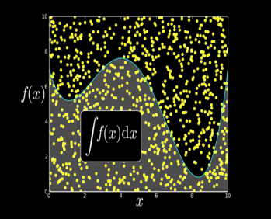
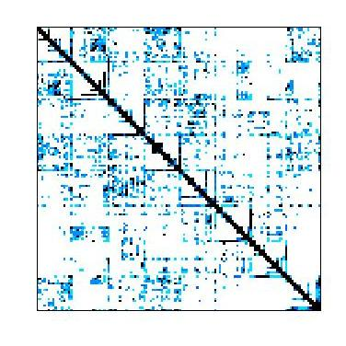










Some GPU-accelerated Libraries
NVIDIA cuBLAS
NVIDIA cuRAND
NVIDIA cuSPARSE
NVIDIA NPP
Vector Signal Image Processing
GPU Accelerated
Linear Algebra
Matrix Algebra on GPU and Multicore
NVIDIA cuFFT
Building-block Algorithms for CUDA
Sparse Linear Algebra
C++ STL Features for CUDA
IMSL Library
ArrayFire Matrix Computations

Slide 70

Matrix Multiplication. Results
Sequential code:
CPU: Intel Core i7 58-20K 3,3 GHz
Dram: 16 GB
GPU code:
Name :GeForce GTX 960
Compute capability : 5.2
 | Execution Time | Rate
Sequential code | 69773,2 | -
Global Memory | 3230 | 21,6
Shared Memory 1 | 3151,4 | 22,14
Shared Memory 2/3 | 1652 | 42,5
Shared Memory 4 | 1421,5 | 49,1
Shared Memory 5 | 1258,8 | 55,4
CUBLAS | 188 | 371

Slide 71

Just one “but”…
Sequential code:
CPU: Intel Core i7 58-20K 3,3 GHz
Dram: 16 GB
GPU code:
Name :GeForce GTX 960
Compute capability : 5.2
 | Execution Time (Debug) | Rate (Debug) | Execution Time (Release) | Rate (Release)
Sequential code | 69773,2 | - | 35665,4 | -
Global Memory | 3230 | 21,6 | 188,2 | 189,5
Shared Memory 1 | 3151,4 | 22,14 | 179 | 199,2
Shared Memory 2/3 | 1652 | 42,5 | 80,7 | 442
Shared Memory 4 | 1421,5 | 49,1 | 45,7 | 780,4
Shared Memory 5 | 1258,8 | 55,4 | 37,3 | 956,2
CUBLAS | 188 | 371 | 187,4 | 190,3

Slide 72
3 Ways to Accelerate Applications
Applications
Libraries
OpenACC Directives
Programming Languages
“Drop-in” Acceleration
Easily Accelerate Applications
Maximum Flexibility

Slide 73

OpenACC Directives
CPU
GPU
Simple Compiler hints
Compiler Parallelizes code
Works on many-core GPUs & multicore CPUs
Program myscience
... serial code ...
!$acc kernels
do k = 1,n1
do i = 1,n2
... parallel code ...
enddo
enddo !$acc end kernels
... End Program myscience
OpenACC
compiler
Hint
Your original
Fortran or C code

Slide 74
OpenACC Directives
Easy: Directives are the easy path to accelerate compute intensive applications
Open: OpenACC is an open GPU directives standard, making GPU programming straightforward and portable across parallel and multi-core processors
Powerful: GPU Directives allow complete access to the massive parallel power of a GPU

Slide 75
Further read
CUDA Programming Guide,
http://docs.nvidia.com/cuda/cuda-c-programming-guide/
CUDA C Best Practices Guide,
http://docs.nvidia.com/cuda/cuda-c-best-practices-guide
…

